Slide 1
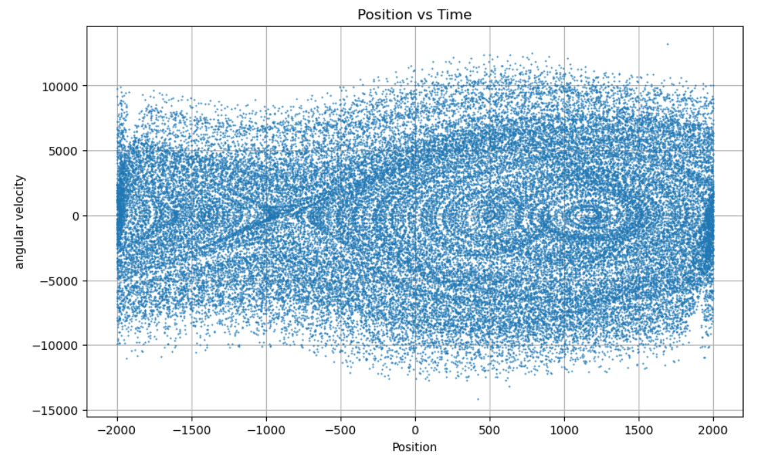
Chaotic Oscillators
By: Bodhi Broderick and Nicholas Proctor

Slide 2
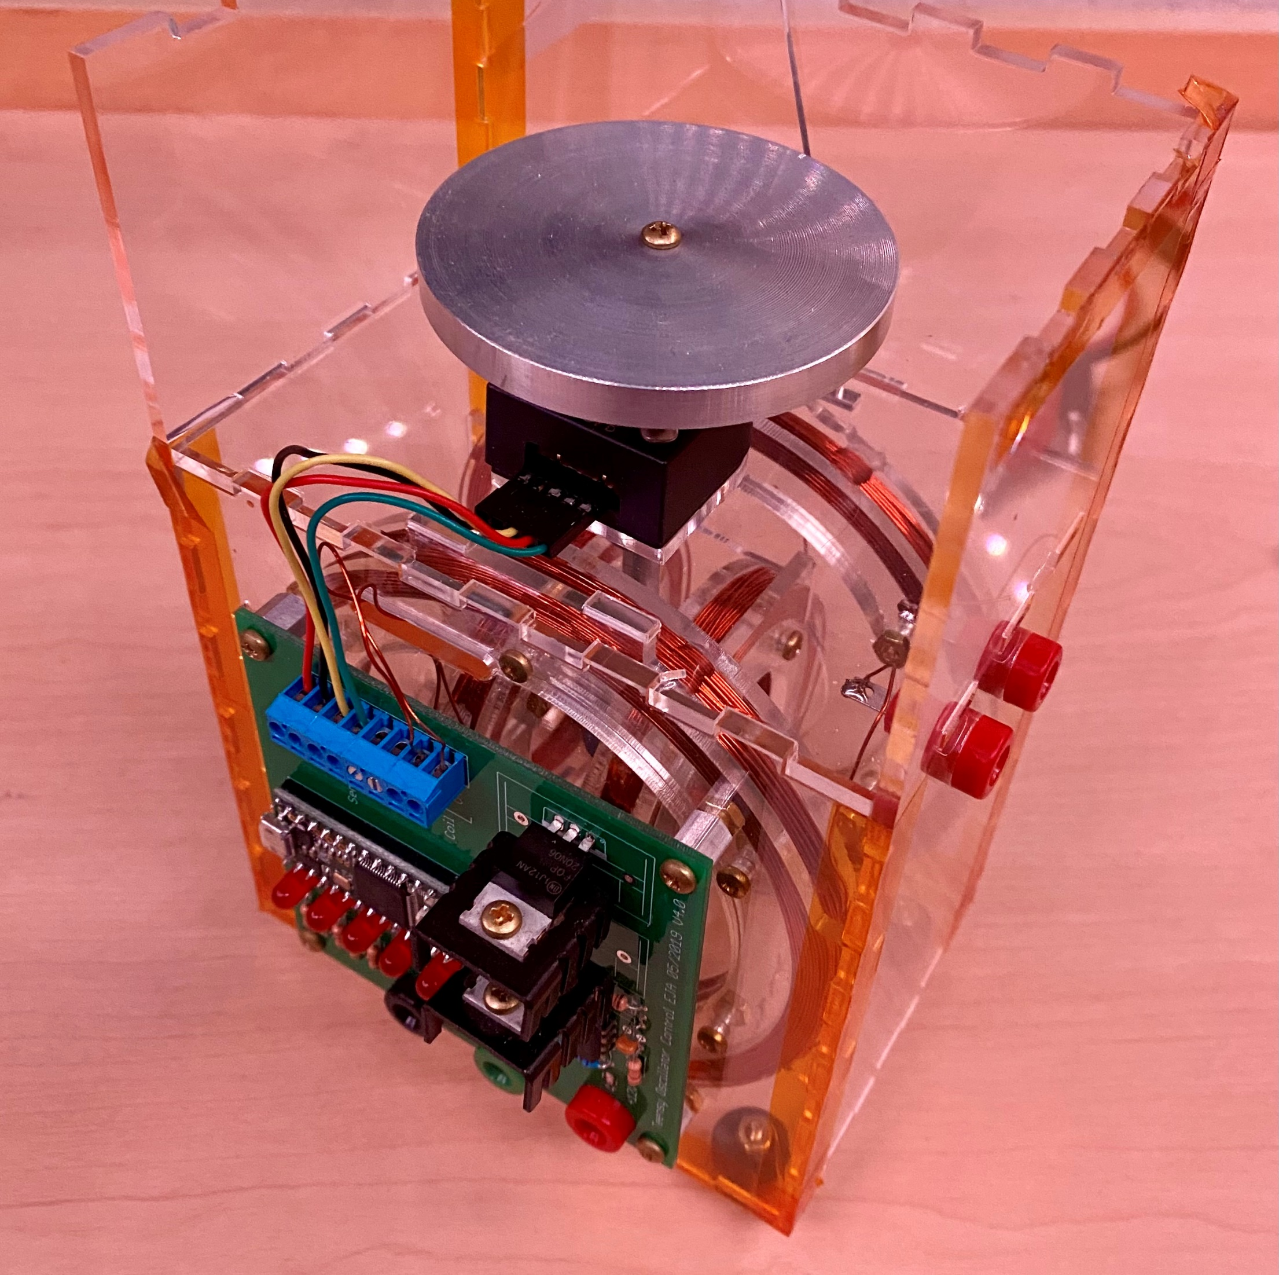
Chaos Theory
Predictable Deterministic Systems that are:
Sensitive to initial conditions
Topologically transitive
Shifts between >1 end conditions
w/ dense periodic orbits
Mechanical Chaotic Oscillator
2 sets of coils => 2 Magnetic Fields
Large orients central magnet
Small toggled to create chaotic oscillation

Slide 3
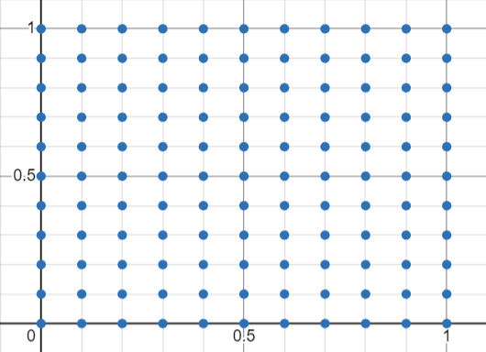
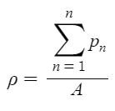
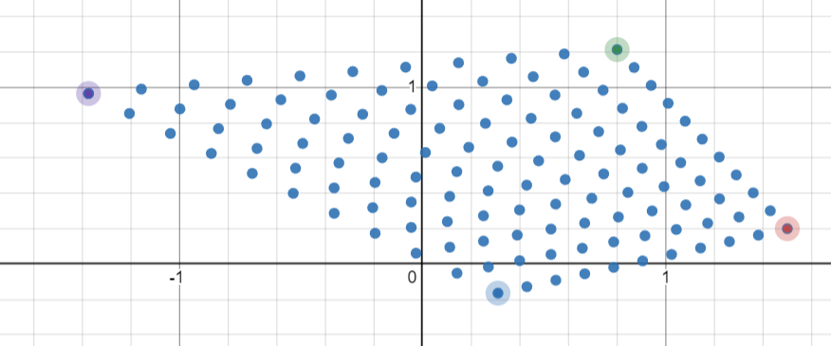
Point Density
Not ↓ why?
What is the point density of =>?
121
400
100
Tell me

Slide 4
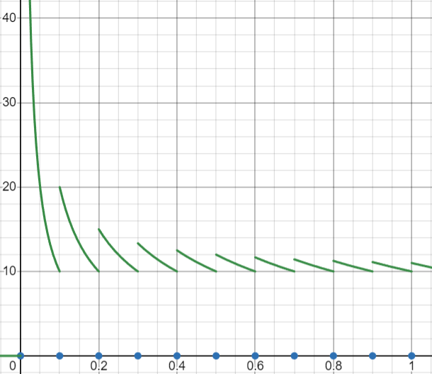

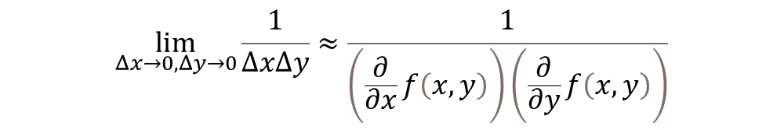
Disproof of 121
Scalability
Dependent on length of the segment
Should be constant for given case
Arbitrary designation of segment ends
Limit as x -> inf
$$\lim_{x→∞}{\frac{1+\left\lfloor 10x\right\rfloor }{x}}=10$$
$$\lim_{Δx→0,Δy→0}{\frac{1}{ΔxΔy}}≈\frac{1}{\left(\frac{∂}{∂x}f\left(x,y\right)\right)\left(\frac{∂}{∂y}f\left(x,y\right)\right)}$$

Slide 5
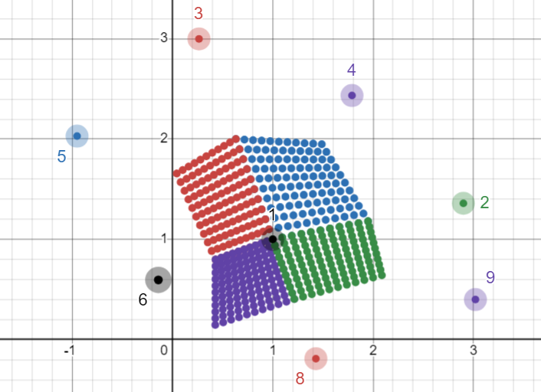
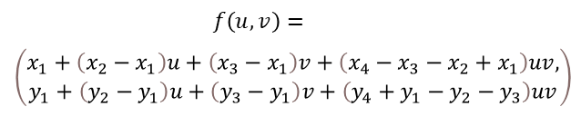
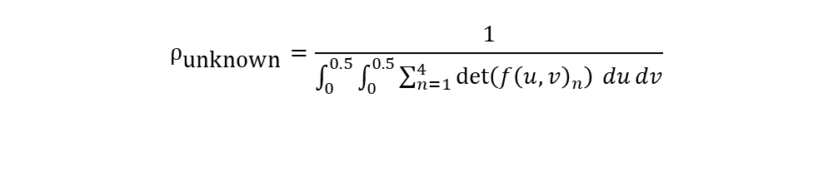
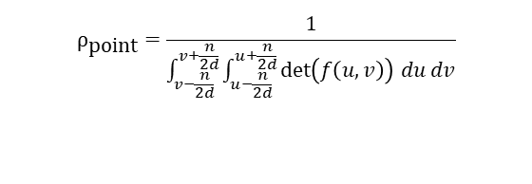
Properties of Point Density
Scalability
Full Area-Coverage
No Arbitrary Bounding
Consistency
$$ρ_{\text{unknown}}=\frac{1}{\int_{0}^{0.5}{\int_{0}^{0.5}{\sum_{n=1}^{4}{\det\left(f{\left(u,v\right)}_{n}\right)}}} du dv}$$
$$f{\left(u,v\right)}_{1}=$$
$$\left(x_{1}+\left(x_{2}−x_{1}\right)u+\left(x_{3}−x_{1}\right)v+\left(x_{4}−x_{3}−x_{2}+x_{1}\right)uv, { y}_{1}+\left(y_{2}−y_{1}\right)u+\left(y_{3}−y_{1}\right)v+\left(y_{4}+y_{1}−y_{2}−y_{3}\right)uv\right)$$
$$ρ_{\text{point}}=\frac{1}{\int_{v−\frac{n}{2d}}^{v+\frac{n}{2d}}{\int_{u−\frac{n}{2d}}^{u+\frac{n}{2d}}{\det\left(f\left(u,v\right)\right)}} du dv}$$
$$f{\left(u,v\right)}_{2}=$$
$$\left(x_{1}+\left(x_{6}−x_{1}\right)u+\left(x_{3}−x_{1}\right)v+\left(x_{5}−x_{3}−x_{6}+x_{1}\right)uv, y_{1}+\left(y_{6}−y_{1}\right)u+\left(y_{3}−y_{1}\right)v+\left(y_{5}+y_{1}−y_{6}−y_{3}\right)uv\right)$$
$$f\left(u,v\right)=$$
$$\left(\begin{aligned}x_{1}+\left(x_{2}−x_{1}\right)u+\left(x_{3}−x_{1}\right)v+\left(x_{4}−x_{3}−x_{2}+x_{1}\right)uv, \\ y_{1}+\left(y_{2}−y_{1}\right)u+\left(y_{3}−y_{1}\right)v+\left(y_{4}+y_{1}−y_{2}−y_{3}\right)uv\end{aligned}\right)$$
$$f{\left(u,v\right)}_{3}=$$
$$\left(x_{1}+\left(x_{6}−x_{1}\right)u+\left(x_{8}−x_{1}\right)v+\left(x_{7}−x_{8}−x_{6}+x_{1}\right)uv, y_{1}+\left(y_{6}−y_{1}\right)u+\left(y_{8}−y_{1}\right)v+\left(y_{7}+y_{1}−y_{6}−y_{8}\right)uv\right)$$
$$f{\left(u,v\right)}_{4}=$$
$$\left(x_{1}+\left(x_{2}−x_{1}\right)u+\left(x_{8}−x_{1}\right)v+\left(x_{9}−x_{8}−x_{2}+x_{1}\right)uv, y_{1}+\left(y_{2}−y_{1}\right)u+\left(y_{8}−y_{1}\right)v+\left(y_{9}+y_{1}−y_{2}−y_{8}\right)uv\right)$$

Slide 6
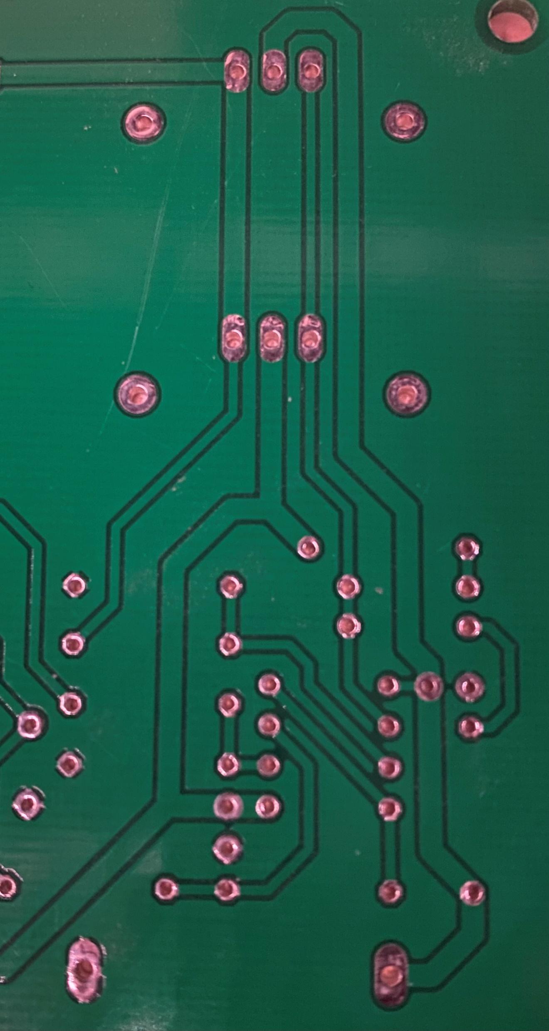
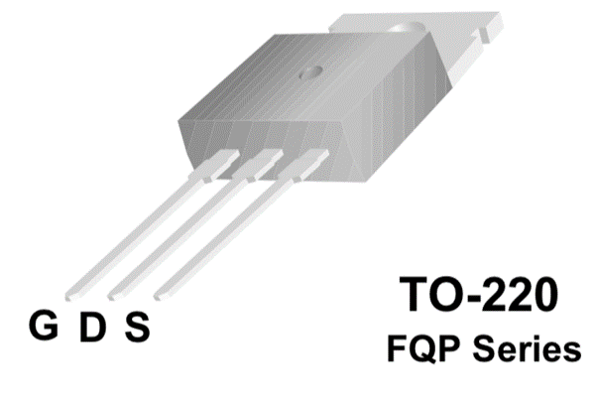
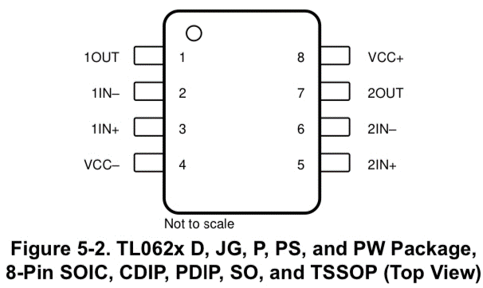


Circuit Analysis
Microchip Toggling
AC current generation
Potential Faults
Microcontroller
Microchip
Shorting ground?
No voltage to toggle port

Slide 7



Simulation & Forces
Resistance
Length of Wire
Num coils
Glowscript?
Computational solution
$∀t≥0∈R$ | I approximated
Rotational velocity and angle updated
Magnet’s interaction on strange attractors
w/o rotational friction
2-body problem?
w/ rotational friction
3-body problem?

Slide 8



Code Summary
XX.XXX…
XXXX YYYY XXXX.XXX…
XXXX XXXX XXXX.XXX…
XXXX YYYY XXXX.XXX…
XXXX ZZZ\n
Filter Out Fragmented Inputs
Find Most Repeated Value
Send to csv
200 data points/sec
15-350 data points/sec
Send Completed Trial to Completed Folder
To storage: 856GB
Redundancy
2024-03-26 8:00AM AMPLXXX 100FREQYYY
Completed
300GB
300GB
256GB

